Slide 1
CONVERTER FOR SCIENTIFIC UNITS (Testing Using APPIUM)
Name : G. Vishnu Vardhan
Reg No : 192011079
Dep.t : CSE
Subject : Software Testing for Android Applications
Code : CSA3731
Date : 31 - 01 - 2023

Slide 2
PROJECT INCLUDES
Objective
Abstract
Proposed System
Flow chart
Concept map
No of Test Cases
Apps and Tools Installation
Appium Server
Implementing Testing
Test Case Outcomes
Conclusion

Slide 3
OBJECTIVE
To Test the different strategies (Test Cases) on Unit Converter Application.
To find all possible Outcomes (Positive and Negative) of the Test.

Slide 4
ABSTRACT
Unit converter consists of many conversions like force, energy , time etc.
User can give Input of Scientific Units.
It consists of parameters for every Unit.
For every unit you can change the parameters.
Based on Parameters you can we can convert all the scientific units present in it.
User Can get the Output in Desired Parameter.

Slide 5
PROPOSED WORK
Test cases like App Launch , Performance , Conversions and Parameters will be Tested.
Testing is done using Appium Software.
To test First Install Android Studio , IntelliJ and Appium Software.
Develop Unit Converter Application in Android Studio.
Run the Application using Android Studio Emulator.
Then find the Positive and Negative outcomes of Testing.

Slide 6
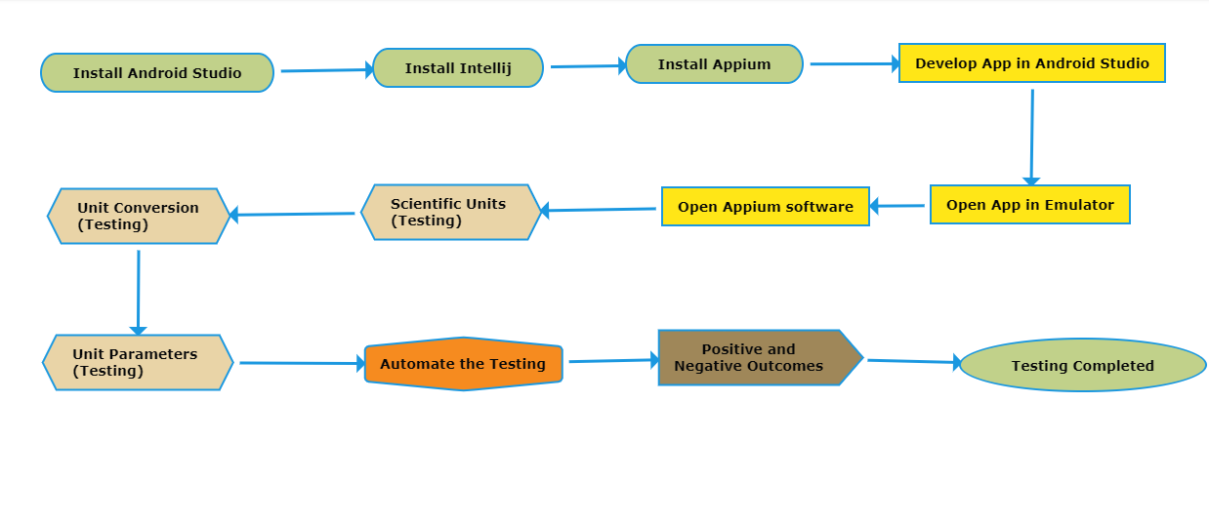
DATA FLOW DIAGRAM

Slide 7
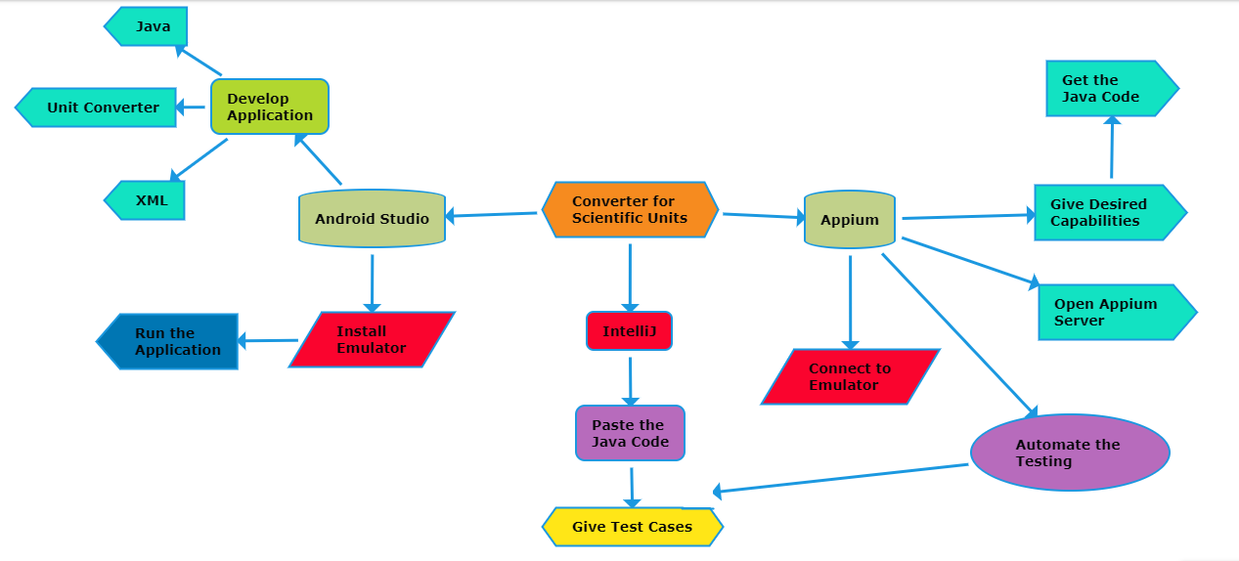
CONCEPT MAP

Slide 8
NUMBER OF TEST CASES
App Launch
User Name
Temp Converter
Weight converter
Time Converter
String Input
Performance
Clear Input Button
Font Color , Size
Parameters of all converters

Slide 9



APPLICATIONS USED
APPIUM
INTELLIJ
ANDROID STUDIO

Slide 10
APPS AND TOOLS
Appium
Open source Automation tool.
It is also a Automation Framework.
Automates different types of mobile applications testing.
It can test web , Native and Hybrid application.
It supports multiple programming languages.
(Java , python , ruby and many more )
6.It works on Emulator as well as Real Devices.

Slide 11
APPS AND TOOLS
Android Studio
It is Integrated development Environment.
It has fast Emulator for App Testing.
Used to Develop applications for Android devices.
It is an open source software.

Slide 12
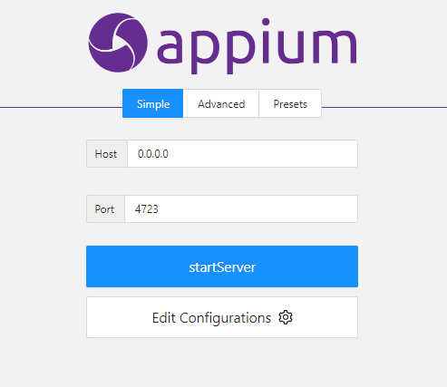
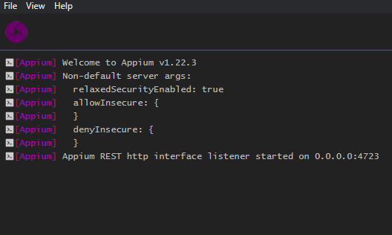
APPIUM SERVER
Before starting server
After starting Server

Slide 13
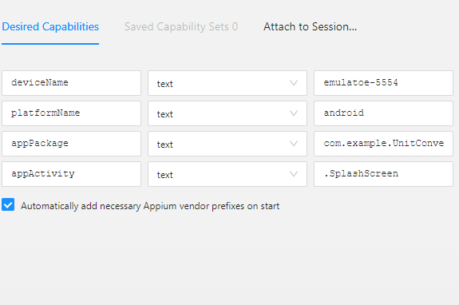
DESIRED CAPABILITIES(APPIUM INSPECTOR )
Give the Desired Capabilities in Appium Inspector.
It will start the session and gives you java code to start testing.
Paste the code in IntelliJ IDE and Start the Testing.

Slide 14
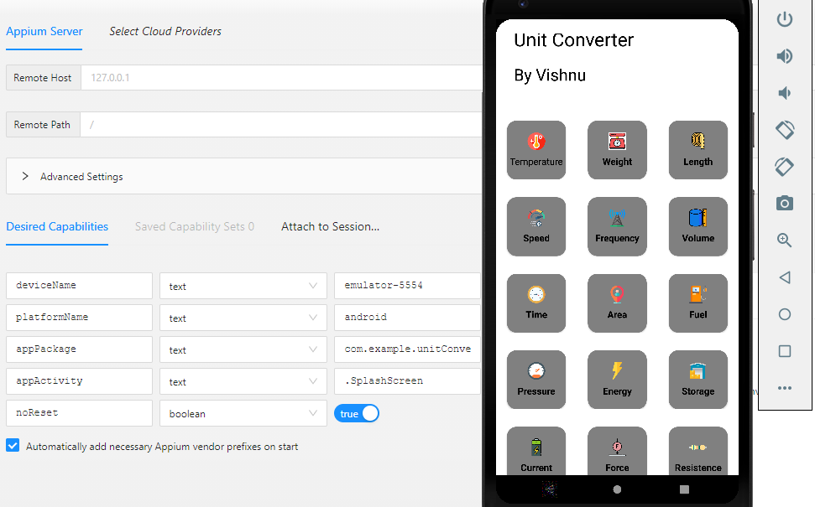
IMPLEMENTATION AND TESTING

Slide 15
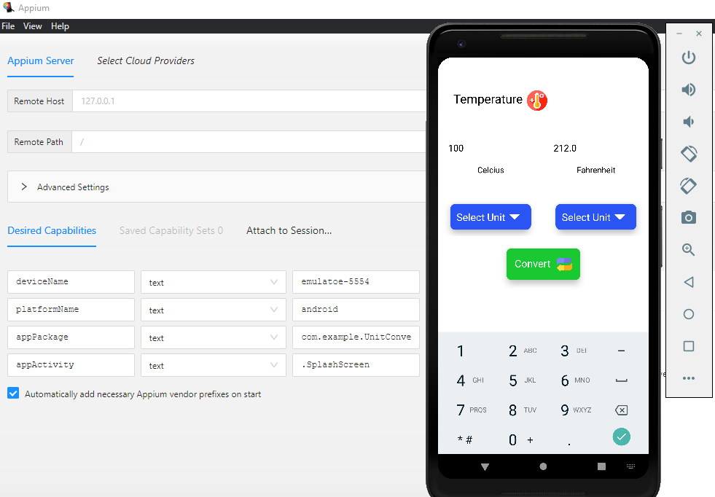
IMPLEMENTATION AND TESTING

Slide 16
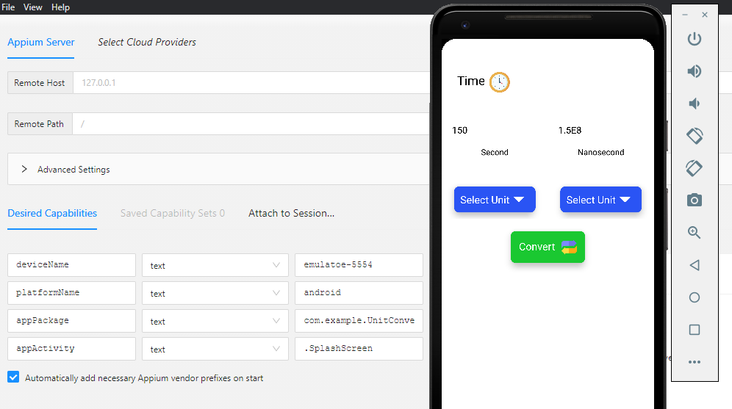
IMPLEMENTATION AND TESTING

Slide 17
TEST CASE OUTCOMES
Test Cases | Outcome
1.Verify the application launch in Emulator | Positive
2.Check whether the User Name is visible | positive
3.Verify User can use Temperature Converter | positive
4. Verify User can use Weight Converter | positive
5. Verify User can use Time Converter | positive
6.Check Whether User can give String input | Negative
7.Verify the Performance of Application | positive
8.Verify User can clear the input | positive
9.Verify Use can change Font size and Colour | Negative
10.Check the parameters of all converters | positive

Slide 18
CONCLUSION
All the Units , Conversions , Parameters and Possible Outcomes were Tested using the Appium Server.
Both Positive and Negative Outcomes were found
80 Percentage of the Test cases were positive.
20 percentage were negative.
By enabling String Input and Font size , Colour Changes we can Overcome Negative Outcomes.

